Slide 1
Queue
Pro Academy I
Data Structure
Notes:
By leonardi.l

Slide 2
Definition
Collection of elements that mimic queuing system
Enqueue : Add element to the queue, at its back
Dequeue : Get element from the queue, at the fronts
Thus, it is a FIFO (First In First Out) collection
Can be implemented using Array or Linked List

Slide 3
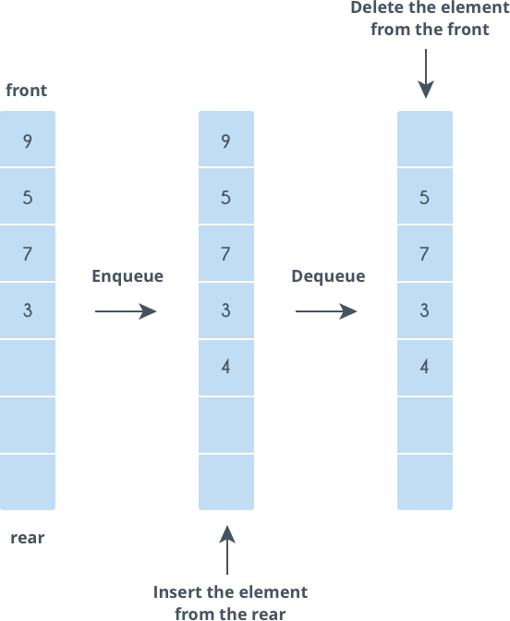
Queue

Slide 4
Operations
Enqueue: Adds an item to the queue.
Dequeue: Removes an item from the queue.
Front: Get the front item from queue.
Rear: Get the last item from queue.

Slide 5
Variant
Array Queue
Maintain two index : head & tail
Use (mod array_size) to make the data wrap around
Linked List Queue
Maintain two pointer : head & tail
Enqueue = insertLast()
Dequeue = deleteFirst()

Slide 6
Speed
Access | O(1) | Only first element are accessible
Insertion | O(1) | happens at the last element (enqueue)
Deletion | O(1) | happens at the first element (dequeue)

Slide 7
Stack Applications
BFS - Bread First Search
CPU, DISK scheduling
IO Buffers, pipes, file IO
Any system that mimic queue procedure

